Slide 1
Followup
Presentation
For TOUCH New York

Slide 2
Visual Mockups for Digital Recordkeeping System

Slide 3
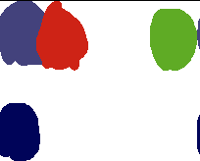
Visual Mockups: Typeface and Color Palettes
The UI design will match the design of the TOUCH website by using the same colors and fonts.
The three colors at the top are all picked from the TOUCH logo. The blue and red at the top should never be used to distinguish between two important items because their brightness is the same. The bottom two colors are picked from the TOUCH website.
Roboto is the font currently being used everywhere on the TOUCH website. It is a clean and simple font designed by Google that is in use on hundreds of popular services and apps.
Roboto

Slide 4
Visual Mockups: Form Language Select
The Client form can start with a screen that allows the user to pick their language.
English
Español
Kreòl

Slide 5
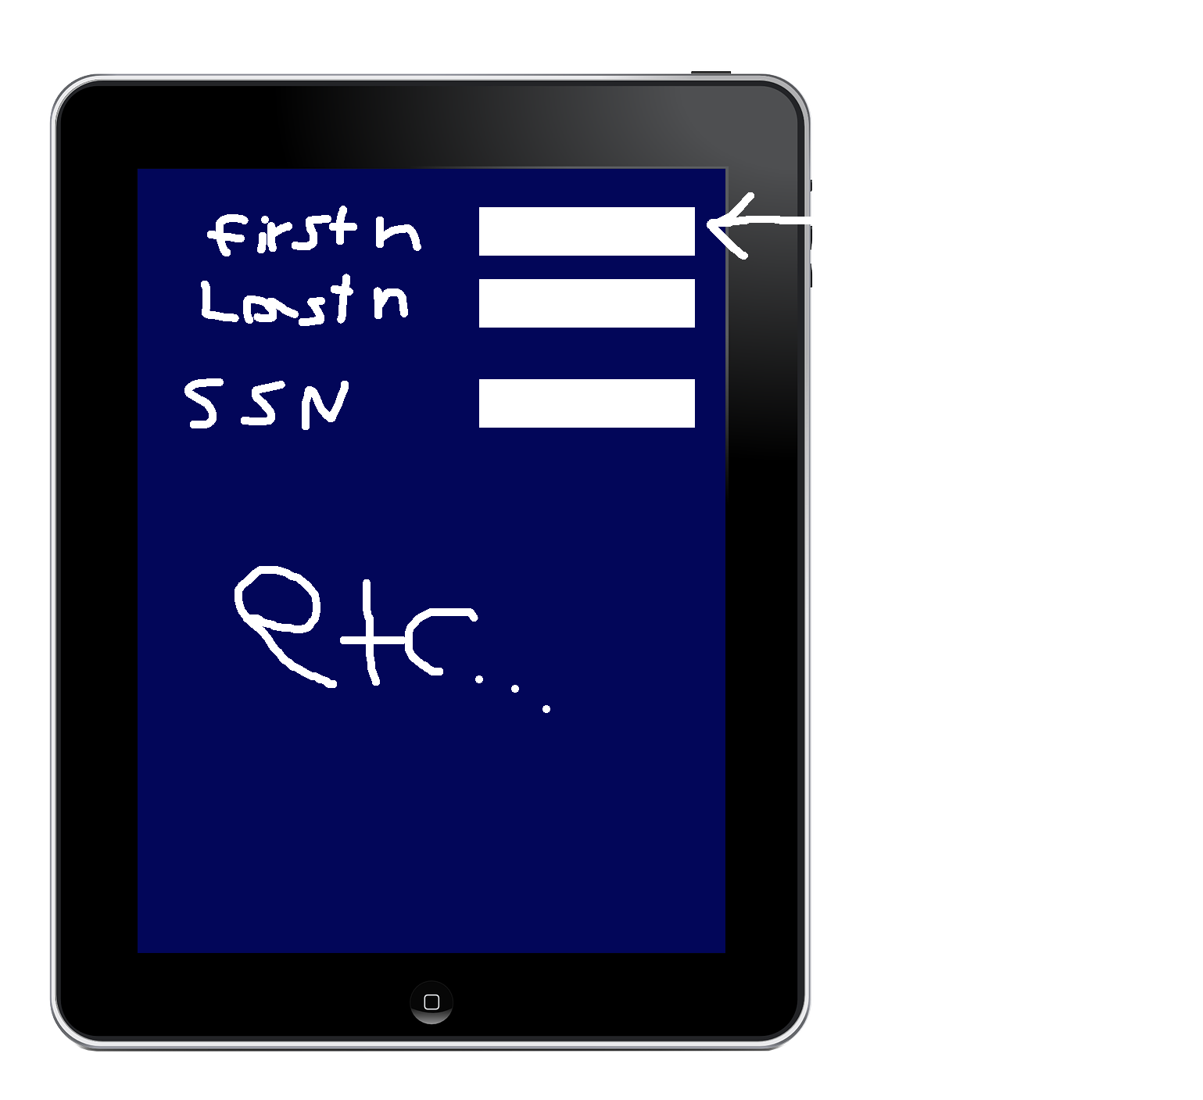
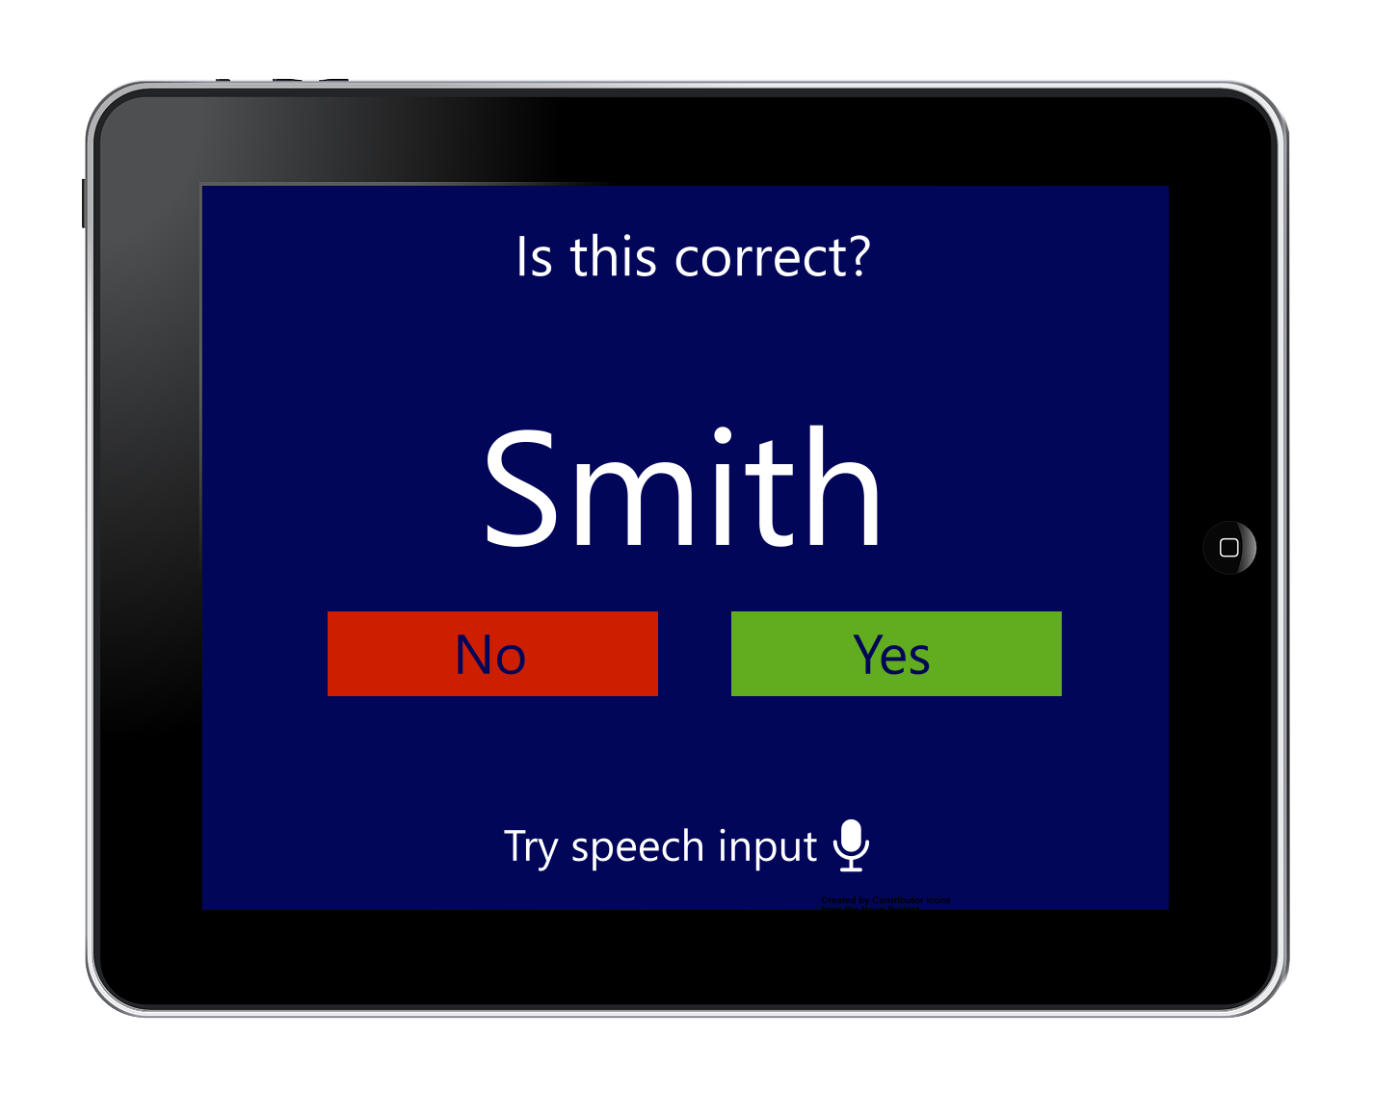
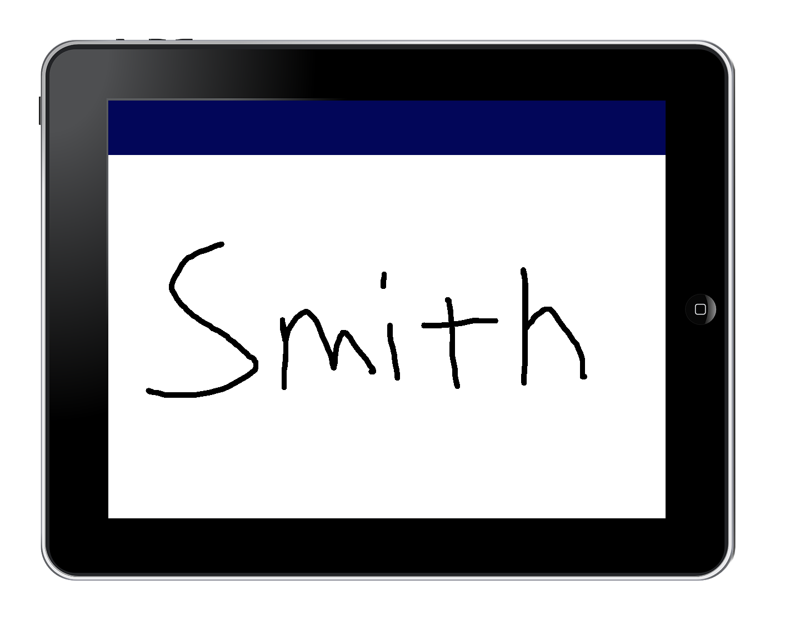
Visual Mockups: Form Interface
Please print your first name

Slide 6
Visual Mockups: Form Number Entry
First Name
3
Last Name
Number of Children
1
2
3
4
5
6
7
8
9
0

Slide 7
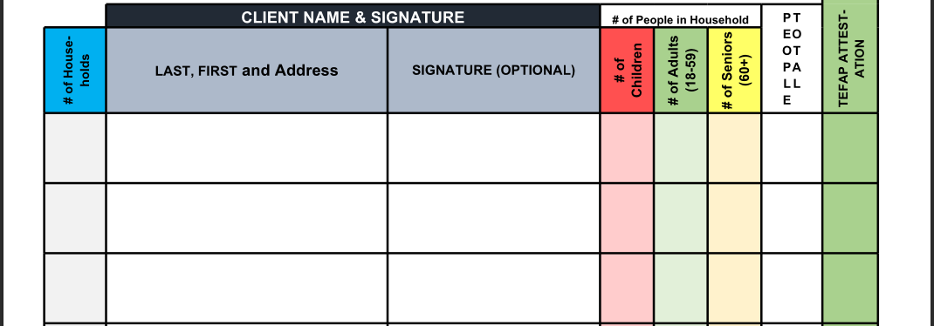
Other Form Study: Feeding Westchester Client Sign-in
TOUCH likely has a paper form similar to this.
This is a paper form. The information probably gets entered twice: once on the paper form and again in a digital spreadsheet.
It seems multiple different clients enter their information on the same form; so clients might see each other’s information.
The vertical text is a bit hard to read.
In conclusion: TOUCH can be a leading innovator in digital record-keeping efficiency in the food distribution industry if they implement digital forms.

Slide 8
Paper Forms are Often Forgotten. Digital Forms and Databases May Help
Often, paper forms are filled out, placed in a filing cabinet, and then forgotten about. For example: I sent a volunteer application to the ASPCA last year; I never heard back.
With digital forms, a system could be set up that immediately sends the data to a database the moment the form is completed. Then, a notification system connected to the database can remind staff of outstanding tasks.
I commend TOUCH for having a digital form system for volunteers in place on their website.

Slide 9
Thank you!

